Slide 1


People
Analytics
CANADARETAIL
STRATEGIC HR PLANNING
Presented by -
Tanmay Jain
Notes:
Hi Everyone,
We're team 2 - Cynthia, Emery, Junda, Nurzhan and me, Tanmay.
Do you know which of your top 2 competitors are listed in the top employer's in Canada list?
Best Buy Canada, and Canadian Tire.
Do you know why?
Because they hire the right talent and then retain them.
Well things are not going so well for CanadaRetail. The revenues are not growing consistently, stores are not hitting targets, employees seem unhappy and diversity related issues.
Our team will walk you through the current state of your company while pointing out some of those issues that we think, if rightly addressed can help improve employability, which is attracting the right talent and retention, retaining that talent.
And both these together shall help you improve your performance
and GET YOU IN that top employer list!!:)

Slide 2







TABLE OF CONTENT
Considerations
Recommendation
Objectives
Implementation
Identifying Issues
Appendix
Insights

Slide 3

Objectives
01
Create positive employer branding to attract top talent
02
Retain top talent stratigically

Slide 4


IDENTIFYING ISSUES

Slide 5
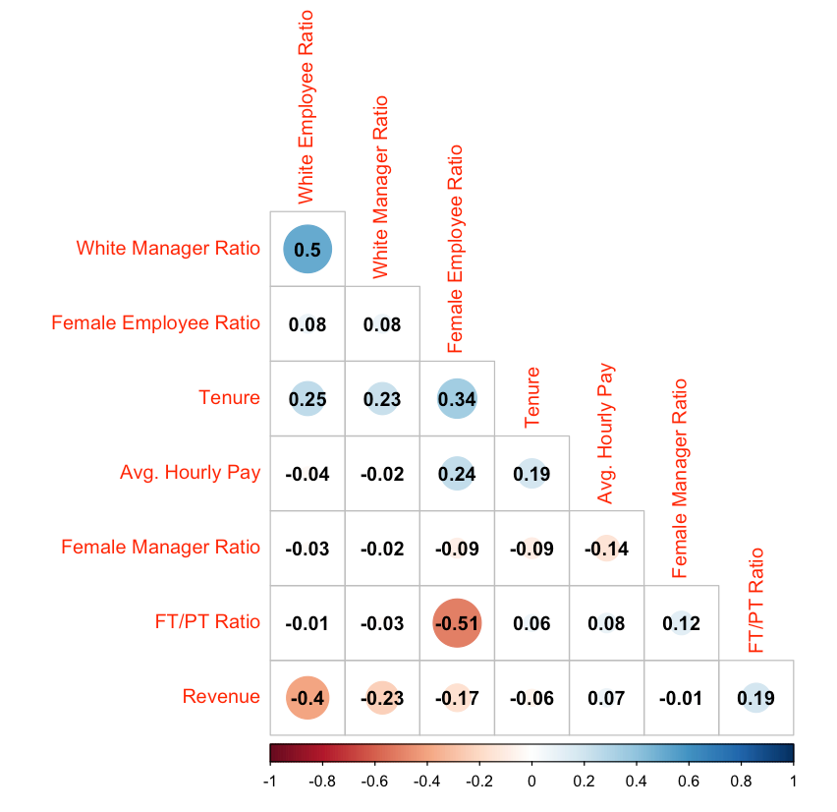
Pairwise Correlation
Insights
White Manager Ratio vs. White Employee Ratio:
Positively Correlated: 0.5
White Manager Ratio increases as White Employee Ratio increases
Female Employee Ratio vs. FT/PT Ratio:
Negatively Correlated: -0.51
Female Employee Ratio decreases as FT/PT Ratio increases
Female Employee Ratio vs. Tenure:
Positively Correlated: 0.34
Tenure increases as Female Employee Ratio increases
Notes:
We looked at Pairwise Correlation for select attributes we want to consider when looking into the strategic planning for our HR practice. We included demographic related attributes, such a race, gender, and tenure; pay and personnel related attributes, such as Avg. Hourly Pay and FT/PT Ratio; and financial metric Revenue.
From the chart, we can then pinpoint to a couple highly correlated pairs that we want to further dive into.
Through these correlation pairs we were able to identify two issues.

Slide 6
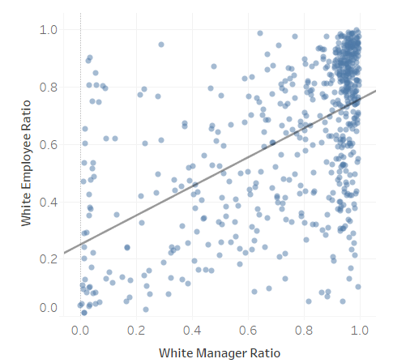
Issue: Attract
Like-Me Bias
Issue
White Manager Ratio vs. White Employee Ratio: Positive Correlation
Like-Me Bias
Causes people to disproportionately favor individuals who are similar to themselves.
Similarities could be race, gender, nationality, career history, educational background, etc.
Notes:
The first issue is regarding attracting talent.
From the high positive correlation between White Manager Ratio and White Employee Ratio, we identified an issue of Like-Me Bias (Similar-to-Me Bias). It is a known bias that people tend to unconsciously hire individuals that are similar to themselves. These similarities include but are not limited to race, gender, nationality, career history, educational background. In our case, race is an issue for Like-Me Bias.

Slide 7
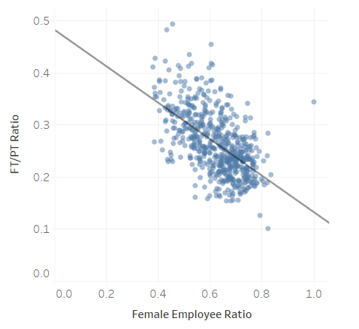
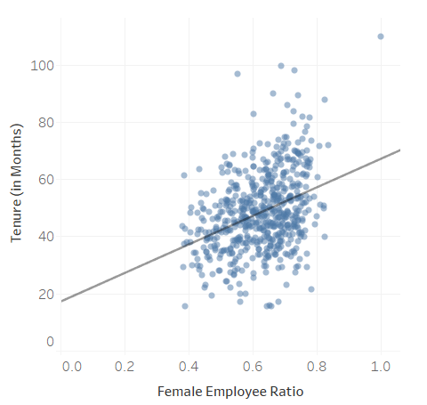
Issue: Retain
Gender Bias
Issue
Female Employee Ratio vs. FT/PT Ratio:
Negative Correlation
Gender Bias
Gender bias might be a cause for hiring females more as part-time workers than full-time, due to stereotypes of women being less committed to their jobs which may lead to turnover. Yet, we see that Female Employee Ratio is positively correlated with Tenure (0.34).
Notes:
The second issue with identified from the Pairwise Correlation table is related to retaining talent.
From the negative correlation between Female Employee Ratio and FT/PT Ratio, we identified an issue with Gender Bias.
In our case, this could be due to stereotypes of women tending to be more family oriented and hence less job committed, which could be a concern for turnover. This bias might be the cause for the negative correlation between Female Employee Ratio and FT/PT Ratio. However, as an evidence against this bias, we can see from our Pairwise Correlation chart that Female Employee Ratio and Tenure is positively correlated.

Slide 8
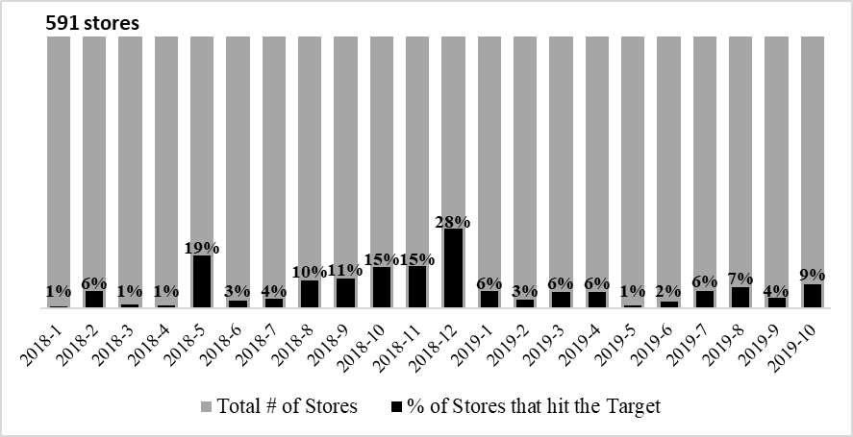
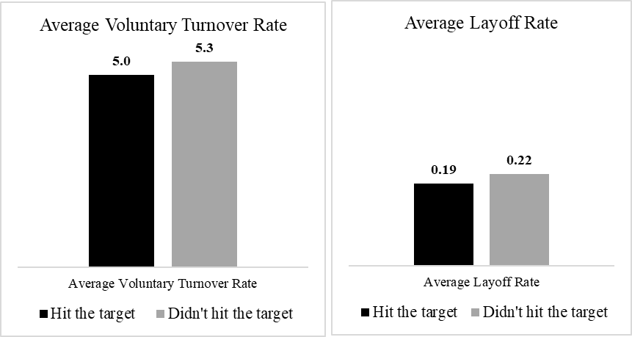
Issue: Retain
Setting Unrealistic Targets
% of Stores that hit the Monthly Revenue Target
Stores that hit Target vs Stores that didn't hit Target
Unrealistic Targets
sfdsfsdfsdfsdf
Setting unattainable Sales Revenue Target might affect the employee salary bonus and, thus, the motivation to stay in the company:
Only a few stores were able to hit the monthly Revenue Target in the last 2 year period
Stores that did not hit the Revenue Target had a higher Voluntary Turnover and Layoff Rates
Notes:
- Salesmen salary in the industry: commissions, performance bonuses, benefits
- Sales Associate salary at Best Buy - 60% fixed base, 40% additional payout
- Of 591 stores, max of 27.9% hit the Revenue Target; average in other months - 6.4%
- Stores that didn't hit the Revenue Target have a higher Voluntary Turnover and Layoffs rates

Slide 9
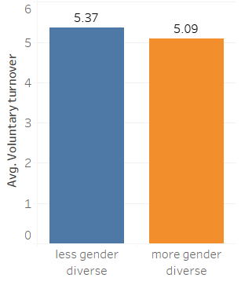
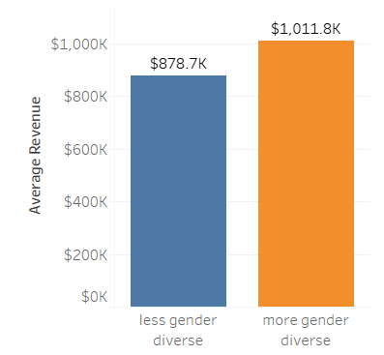
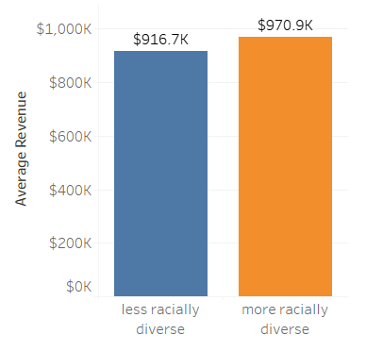
Issue: Diversity
Why Diversity matters? How Diversity adds Value?
Ratio of females > .4 and < .6 have been classified as 'more gender diverse' group.
Ratio of White employees > .4 and < .6 have been classified as 'more racially diverse' group
Out of the five least revenue generating stores, 4 have significantly low gender diversity. (Store no 1415, 3890, 8238, 8618).
Notes:
We categorized stores based on their diversity ratios and found that -
1. that turnover rate is more for less diverse groups.
2. We also see a similar pattern when we look at stores with least revenues and majority of them had less diversity.
However, we clearly see here that average revenues are relatively higher for more diverse groups.
----------------------------------
Both these findings encourage hiring and retaining of more diverse groups, both from a cultural and financial pov.

Slide 10
Diversity
Why Diversity matters? How Diversity affects Performance?
Collaboration & Loyalty
A research by McKinsey found that Diversity improves employee satisfaction and decreases conflicts between teams, boosting collaboration and loyalty
Better Performance
The same research found a statistically significant connection between diversity and financial performance - more gender diverse companies were 15% more likely and more racial/ethnic diverse companies were 35% more likely to have financial returns than national industry median
Notes:
McKinsey & Company research on Diversity:
- There exists a statistically significant relationship between a more diverse team and financial performance
- Diversity fosters innovation, creativity, employee satisfaction, collaboration and loyalty. Also, it reduces conflicts b/w groups
- Companies could benefit from improving racial/ethnic, gender, sexual diversity

Slide 11
INSIGHTS

Slide 12
Retention Predition Model
Model to predict employee turnover in our company
Enterprise Factors
Better work life balance, culture fit, salary, reward fairness and performance fairness help reduce turnover rate of employee.
Employee Satisfaction
More respect, better development opportunities and more clear understanding of the goals help reduce the turnover rate of employees.
Employee Characteristics
Better cognitive ability and less extroverted personalities have less turnover rate.
Notes:
Model used to specifically test which factors affect employee turnover in our company.
- Enterprise factors: work-life balance, culture fit, salary, reward fairness, and performance fairness
- Employee satisfaction: respect, development, and goals
- Employee characteristics: cognitive ability, extraversion

Slide 13

Diversity
Equal Pay for Equal Work
Gender Level
Inequalities
Female employees have greater turnover rate compared to male employees
Female employees have greater turnover rate compared with male employees
Receive lower average salary given same job level, less work life balance and less fair feedback compared with male employees and white employees
Race Level
Non-White employees have greater turnover rate compared with White employees
Notes:
-Pay special attention to employees in specific gender and race groups.
-Differences in turnover of employees in different gender and race level may be driven by inequalities in salary, work-life balance, and fairness of feedback.

Slide 14
RECOMMENDATION & IMPLEMENTATION

Slide 15
RECOMMENDATION
Unrealistic Target
Like-Me Bias
Gender Bias
Promote continuous Unconscious Bias Training
Reforming recruitment processes
Promote continuous Diversity & Inclusion Training
Promote pay equity
Effective Goal Setting
Provide continues training and development plan
Detail provided in Appendix

Slide 16






Implementation
Tone at the TOP - EDI
Understand how management are positioned
Showcase the impacts of a diverse team
Design and implement step by step plan

Slide 17



Implementation
Branding
Creat Diversity & Inclusion video
Notes:
Based on the budget, create a series of videos to showcase your real employee experience.
The video content should be stories from team members from a range of jobs, departments and backgrounds.

Slide 18

Thank You

Slide 19
Appendix
References
Hunt, V., Layton, D., & Prince, S. (2015). Diversity Matters. McKinsey&Company Report. https://www.insurance.ca.gov/diversity/41-ISDGBD/GBDExternal/upload/McKinseyDivmatters-201501.pdf
Al-Suraihi, W. A., Samikon, S. A., Al-Suraihi, A. H. A., & Ibrahim, I. (2021). Employee turnover: Causes, importance and retention strategies. European Journal of Business and Management Research, 6(3), 1-10.
Zhang, Y. (2016). A review of employee turnover influence factor and countermeasure. Journal of Human Resource and Sustainability Studies, 4(2), 85-91.
Singh, A. K., Singh, S., & Singh, A. P. (2014). Personality traits and turnover intention among front level managerial personnel. Journal of the Indian Academy of Applied Psychology, 40(2), 228-236.
Oberai, H. and Anand, I.M. (2018), "Unconscious bias: thinking without thinking", Human Resource Management International Digest, Vol. 26 No. 6, pp. 14-17.

Slide 20
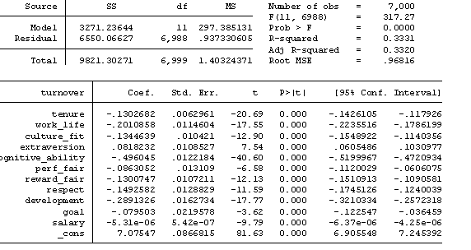
Appendix
Turnover Model-Overall Model
Predictors like work life, culture fit, salary, reward fairness, performance fairness and higher employee satisfaction - respect, development and goal - are shown to reduce turnover rate of employees.
Employees with better cognitive ability and less extraverted personality have less turnover rate compared with other employees

Slide 21
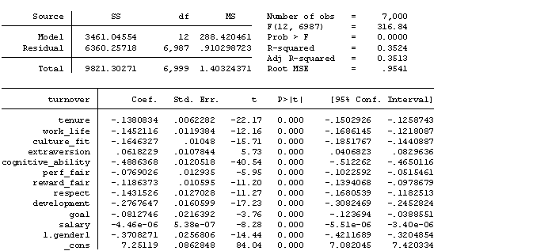
Appendix
Turnover Model-Gender difference in turnover
Male employees have lower turnover ratio than Female employees

Slide 22
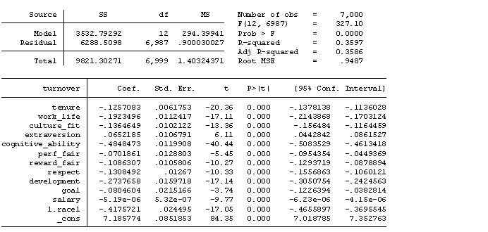
Appendix
Turnover Model-Race difference in turnover
White employees have lower turnover ratio than Non-White employees

Slide 23
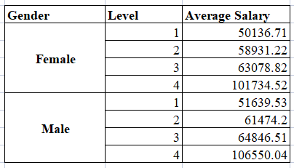
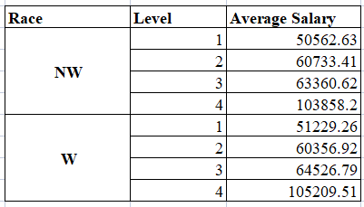
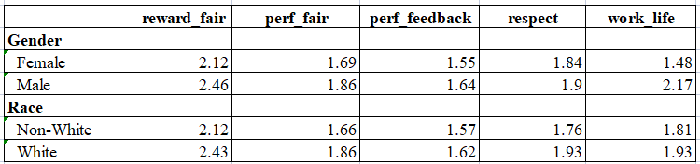
Appendix
Inequalities in gender and race groups

Slide 24
Appendix
Limitations of our model
Limitation
We only have the data in October 2019 to build our model, so we can not accurately predict the turnover rate of the employees.
Forwarding Looking
More detailed data for employee dataset in different years and months

Slide 25
Appendix
literatures show several factors to influence employee turnover
Enterprise Factors
A research from Yanjuan Zhang shows that enterprise culture and system, enterprise benefit , salary, employee involvement, individual work attitude and organizational justice will influence employee turnover.
Employee Satisfaction
A research by Walid Abdullah Al-suraihi found that job dissatisfaction influences the employees to leave the organization.
Employee Characteristics
A research by Akhilendra K. Singh, Sadhana Singh, and A. P. Singh found that personality traits could significantly influence the rention of employees.
Notes:
literatures show factors in the enterprise, employee satisfaction and employee characteristics to affect employee turnover.

Slide 26

Appendix
Implementation
Goal Setting
Determine Your Company’s Goals
Assess the performance of your sales team
Educate and Empower Your Sales Team
Encourage feedback
Assess the Market Potential
Assign goals based on individual ability
Properly Incentivize Your Sales Team

